Slide 1
Intro to Computers
UT LAW 379M
Fall 2021
Lecture Notes

Slide 2
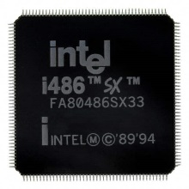
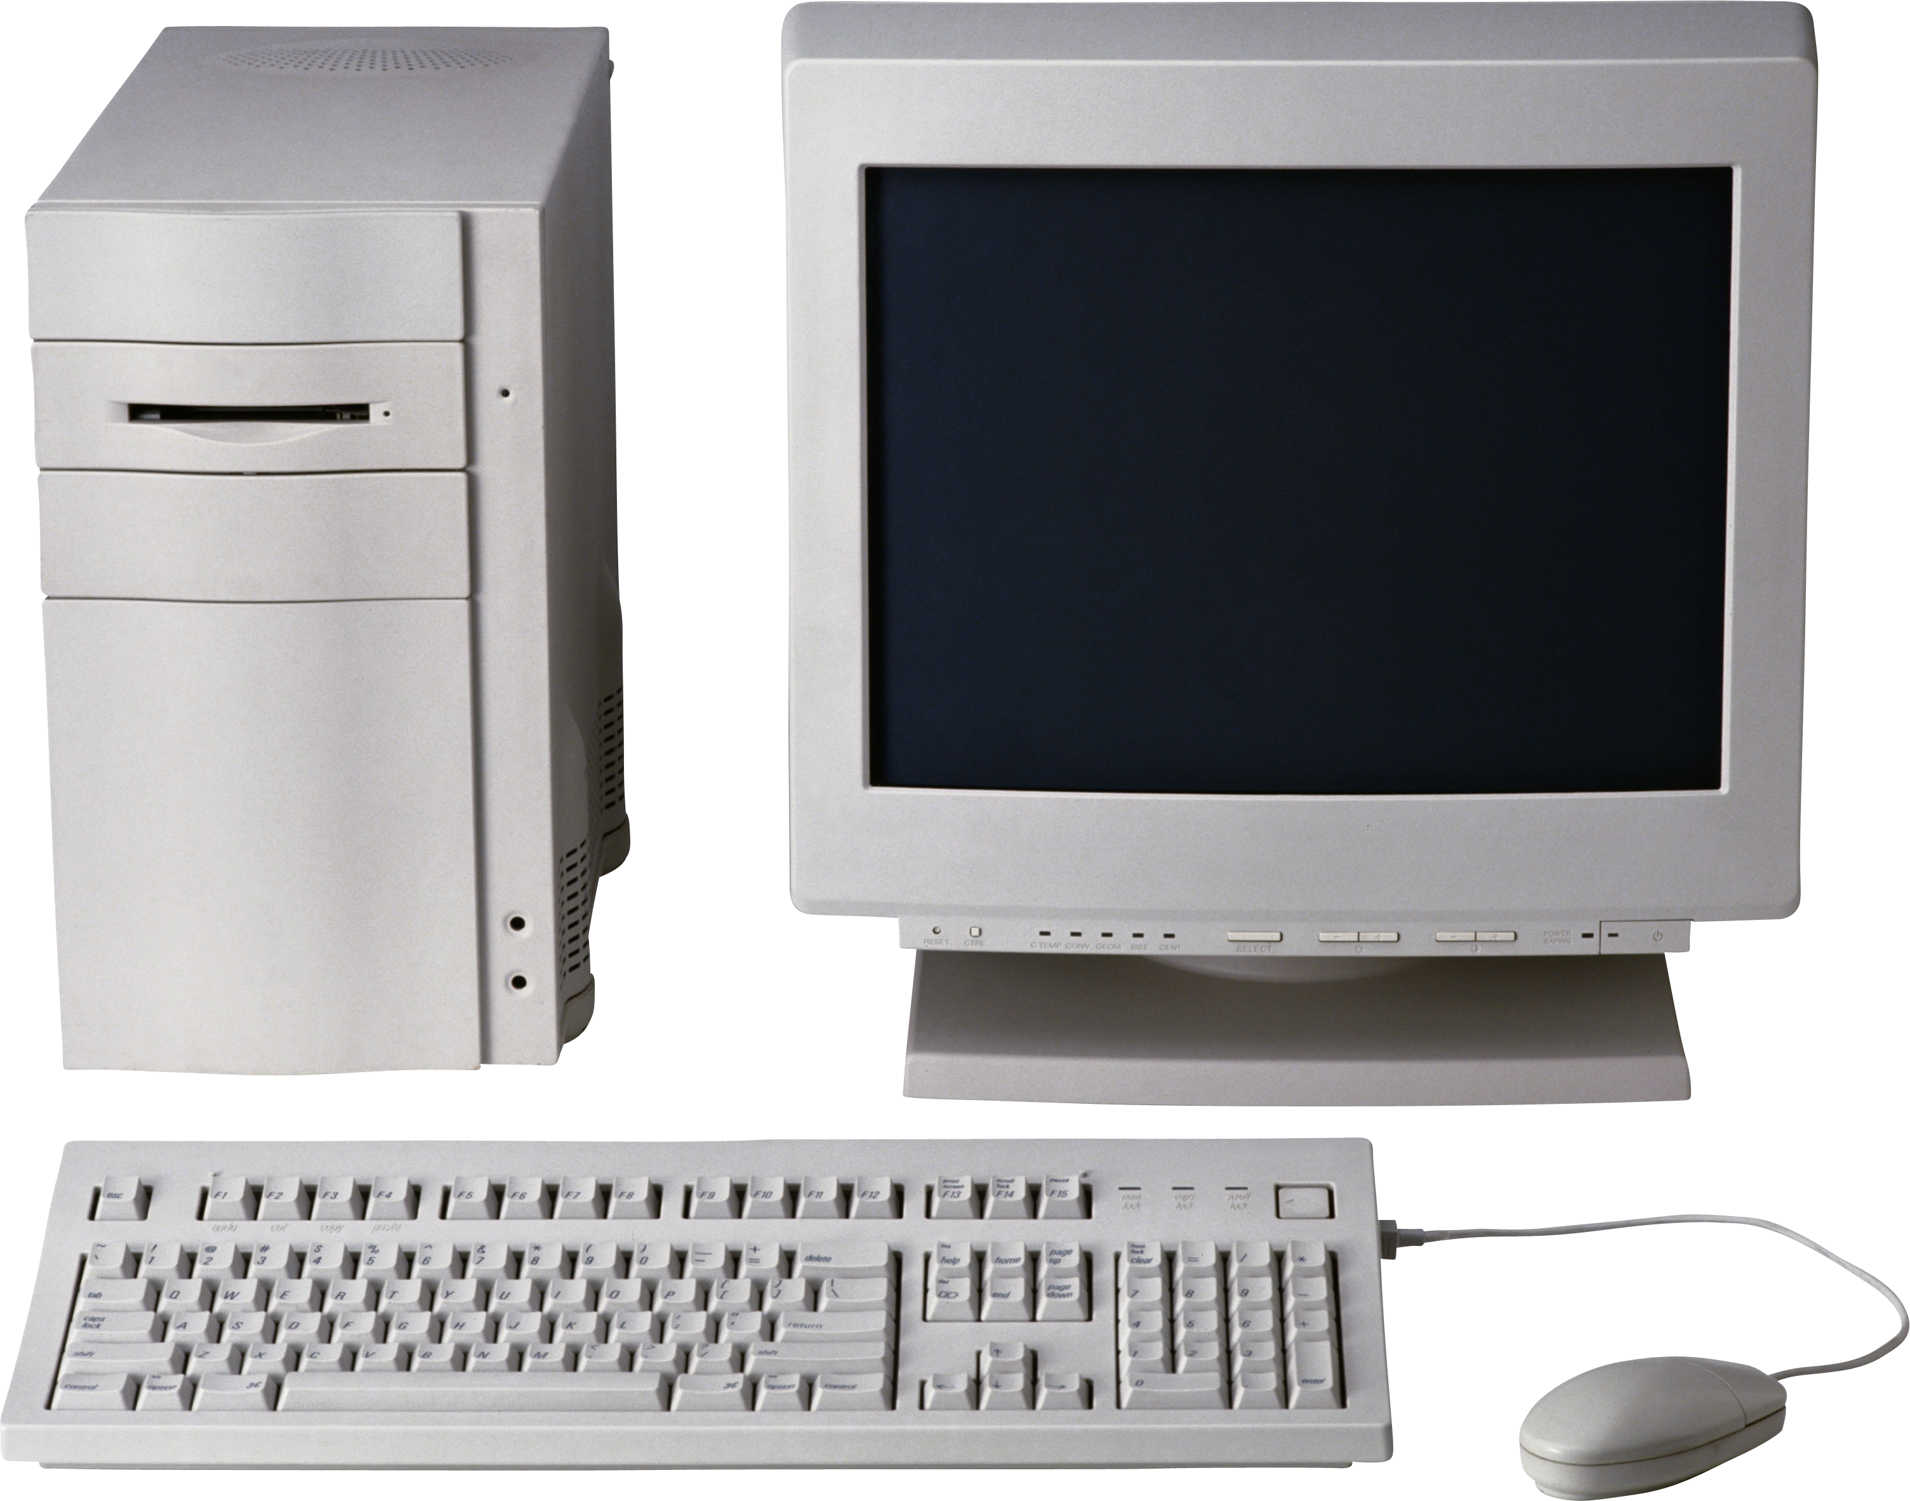
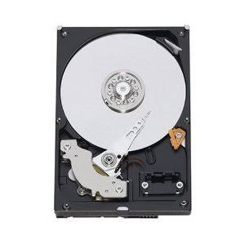
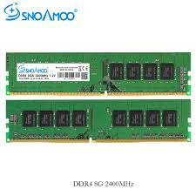
Three Major Computer Parts
Central Processing Unit (CPU)
Hard Drive
Random Access Memory
(RAM)
This Photo by Unknown Author is licensed under CC BY-NC

Slide 3
First, a Word About Data
Computers store and process all data as BINARY NUMBERS
Everything is a binary number. Games, programs, music, etc
The binary numbers are interpreted as letters, music, etc

Slide 4
Quick Binary Lesson
Base 10 Numbers
Base 2 Numbers
10³ = 1000 | 10² = 100 | 10¹ = 10 | 10⁰ = 1
3 | 0 | 9 | 5
(3X1000) + | (0X100) + | (9X10) + | (5X1)
3000 + | 0 + | 90 + | 5
3095
2³ = 8 | 2² = 4 | 2¹ = 2 | 2⁰ = 1
1 | 0 | 1 | 0
(1X8) + | (0X4) + | (1X2) + | (0X1)
8 + | 0 + | 2 + | 0
10

Slide 5
What are These Binary Numbers?
Binary 1000?
Binary 0100?
Binary 0010?
Binary 0001?
Binary 0101?
Binary 1010?
Binary 1111?
Remember 8, 4, 2,1 columns.
If there’s a one, add the column:
0110 = 4+2 = 6
1001 = 8+1 = 9

Slide 6

Decode This Shirt

Slide 7
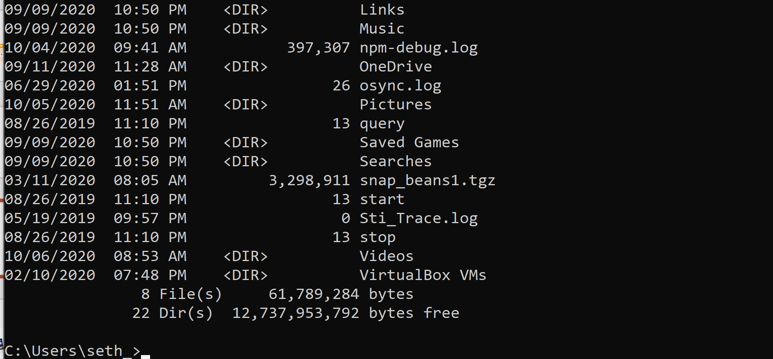
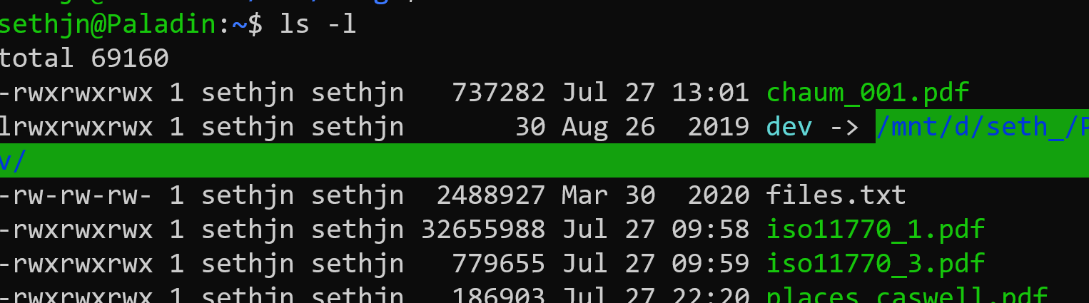
Binary Sizes
A one or a zero is a “bit”
8 bits is a byte
Let’s use our command line to see how big files are:
Open a terminal on Mac or the cmd shell on Windows
Type “ls –l” on Mac or “dir” on Windows

Slide 8
Binary is Often Represented as Hex
Binary is Base 2
For “short hand”, binary is often written in Base 16
This is because there is a 1:1 mapping between 4 bits and 1 Hex number:
0000 – 0 | 0100 – 4 | 1000 – 8 | 1100 – C (hex 12)
0001 – 1 | 0101 – 5 | 1001 – 9 | 1101 – D (hex 13)
0010 – 2 | 0110 – 6 | 1010 – A (hex 10) | 1110 – E (hex 14)
0011 – 3 | 0111 - 7 | 1011 – B (hex 11) | 1111 – F (hex 15)

Slide 9
Convert to Binary/Decimal
0xFF
0x10
0xA3
0x8C
0xF0
0x0F
Please use 8 bits for the binary. Leading 0’s are fine

Slide 10
Convert to Binary/Hex
250
100
128
129
64
32
96 (notice, 64+32)
Please use 8 bits for the binary. Use 2 digits for hex. Leading 0’s are fine

Slide 11
Interpretation - Letters
ASCII – The original English language character mapping
Each letter, symbol, and control character had a code
‘a’ – 97 (decimal), 0x61 (hex), 0110 0001 (bin)
‘A’ – 65 (decimal), 0x41 (hex), 0100 0001 (bin)
Newline – 10 (decimal), 0x0a (hex), 0000 1010 (bin)

Slide 12
ASCII Exercise
ASCII table: https://www.ascii-code.com/
Find the hex codes for “hello world!”
Find the hext codes for your name
Include spaces and punctuation!

Slide 13
Interpretation - Images
Uncompressed pictures can be 1 number per pixel
Each number is an index into a table of colors
1 bit-per-pixel can do two colors (black and white)
8 bpp can do 256 colors
32 bpp can do 4,294,967,296 colors

Slide 14
2x2 BW Image Example
1001
1010

Slide 15
larger BW Image Example
11111 11111
11011 10011
10011 01101
11011 01101
11011 01101
10001 10011
11111 11111
8x10

Slide 16
2x2 4 Color Image Example
00 – Black
01 – Red
10 – Green
11 – White
11000110

Slide 17
Interpretation - Images
Uncompressed pictures can be 1 number per pixel
Each number is an index into a table of colors
1 bit-per-pixel can do two colors (black and white)
8 bpp can do 256 colors
32 bpp can do 4,294,967,296 colors

Slide 18
(Side Note, Compression)
Images can be compressed with special techniques
Groups of same-color pixels stored together
Videos go even further
I frame, full picture
B frame/p frame, changes from previous picture

Slide 19
Interpretation - Documents
Multi-level encoding
Codes indicate whether text is regular, bold, etc
All the data is rendered by the display program

Slide 20
HTML Example
The entire document, except for media, is text
So, there is “interpretation” from binary to text
And more “interpretation” from text to codes
Example:
<B>This is bold</B>
The <B> says “all text until next </B>” is bold

Slide 21
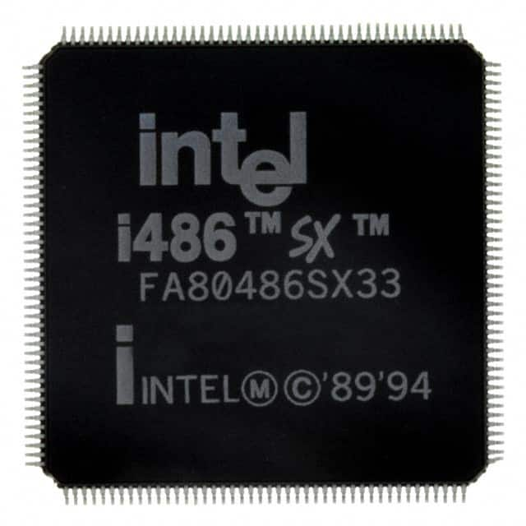
Processors and Binary
Computer “Instruction” is just a binary number. In older computers, like the 486 shown here, it was 32-bit. In more modern processors it is 64-bit.
1 | 0 | 0 | 1 | 1 | 0 | 0 | 0 | 0 | 1 | 1 | 0 | 0 | 1 | 0 | 0 | 0 | 0 | 1 | 1 | 1 | 1 | 1 | 0 | 1 | 0 | 1 | 0 | 0 | 1 | 1 | 0

Slide 22
CPU Instructions
The instruction is broken down into pieces. One part is called the “op code” or operation code, it tells the computer what to do. The other parts are parameters. Each instruction “add”, “subtract,” etc. has its own op code.
1 | 0 | 0 | 1 | 1 | 0 | 0 | 0 | 0 | 1 | 1 | 0 | 0 | 1 | 0 | 0 | 0 | 0 | 1 | 1 | 1 | 1 | 1 | 0 | 1 | 0 | 1 | 0 | 0 | 1 | 1 | 0
OP CODE
PARAMETER 1
PARAMETER 2

Slide 23
Program Stored On Disk
32-bit instruction
32-bit instruction
Program is a list of instructions
Processor executes one at a time.
Some instructions are “branches”
A branch jumps ahead or behind in the list
Often “conditional” (e.g., if x > 0 then jump)
32-bit instruction
32-bit instruction

Slide 24
Running a Program
HARD DRIVE
Program
(List of Instructions)
RAM
Program
(List of Instructions)
Single Instruction
Program is
copied to RAM
(RAM is faster)
1 Instruction at a time
loaded by the processor

Slide 25
Data Too
HARD DRIVE
Program
(List of Instructions)
RAM
Program
(List of Instructions)
Data
Single Instruction
Data File
Instruction can manipulate instructions (branching), read or write from data in RAM or load or save data from files on disk. (All are just binary numbers)

Slide 26
CPU Simulation Example
YOU are going to be a computer processor
You will have 8 bit instructions
add, subtract, multiply, divide
load, store, jump, jump if not zero

Slide 27
8-bit instructions
First 3 bits are the operation:
000 – load 100 – multiply
001 – store 101 – divide
010 – add 110 – jump
011 – subtract 111 – jump if not zero
5 bits for the parameters

Slide 28
Add/Subtract/Mult/Div
3 Parameters (5 bits)
First, add a number (0) or add a register (1) (1 bit)
Second, the destination register (2 bits)
Third, a number or a register (2 bits)

Slide 29
Registers
CPU’s use mini-storage places called registers
A register usually just holds a single number
For our pretend CPU, numbered 0-3 (r0, r1 …)
8-bit number storage in each register

Slide 30
Example Add Number
Instruction: 01000010
First 3 bits: 010 – Add
Next 1 bit: 0 – Add number
Next 2 bits: 00 – register 0 (r0)
Next 2 bits: 10 - 2
“Add r0 and 2 together (store in r0)”

Slide 31
2 bits?!
2 Bits ranges between 0 and 3
What if you want to add more than 3?!
Call add multiple times, use multiply, etc
Real computers aren’t this limited
But have similar problems

Slide 32
Visualized
01000010
R0 | 1000 0000
R1
R2
R3
R0 | 1000 0010
R1
R2
R3

Slide 33
Example Add Register
Instruction: 01010001
First 3 bits: 010 – Add
Next 1 bit: 1 – Add register
Next 2 bits: 00 – register 0 (r0)
Next 2 bits: 01 – register 1 (r1)
“Add r0 and r1 together (store in r0)”

Slide 34
Visualized
01010001
R0 | 1000 0000
R1 | 0000 0010
R2
R3
R0 | 1000 0010
R1 | 0000 0010
R2
R3

Slide 35
Store/Load Commands
2 Parameters (5 bits)
Register to store from/load to(2 bits)
Register with memory address (2 bits)
Last bit ignored

Slide 36
Memory Addresses
Memory locations have addresses
Each address is just a single number
Biggest 8-bit number is 255
With 8 bits, 256 memory addresses (0-255)
(NOTE: This is RAM, not hard drive)

Slide 37
Example Load
Instruction: 00000010
First 3 bits: 000 (load)
Next 2 bits: 00 – Load to Register 0 (r0)
Next 2 bits: 01 – use Register 1 (r1) for memory address
Last bit is ignored

Slide 38
Visualized
R0
R1 | 1000 0000
R2
R3
00000010
R0 | 1010 1010
R1 | 1000 0000
R2
R3
126 | 1111 1111
127 | 0000 0000
128 | 1010 1010
129 | 0101 0101

Slide 39
Where are these instructions?
Instructions ARE IN MEMORY TOO!!!!
Jump and Jump if not Zero are for jumping to instructions!

Slide 40
Jump
1 Parameters (5 bits)
Register with address to jump to
Last 3 bits ignored

Slide 41
Jump if not Zero
2 Parameter (5 bits)
First, jump forward or backward (1 bit)
Second, offset (4 bits)

Slide 42
Wait! Something’s Missing!
Our Jump If Not Zero didn’t specify a register!
What are we comparing to zero?
For our system, designate R3 as the check register
Real systems aren’t this limited
But they use similar tricks

Slide 43
Jump farther?!
We only have four bits for the jump
We can jump forward or back 16 addresses
What if we need to go farther?
We can put a jump instruction where we land

Slide 44
Let’s walk through a program!
Assume that all registers start with 0 in them
Assume that our first instruction is at address 0
Assume that 5 numbers were prestored:
250 – 1 (address 250, decimal value 1)
251 – 2
252 – 4
253 – 8
254 - 16

Slide 45
Instructions I
MEMORY ADDRESS | INSTRUCTION
0000 0000 | 0100 1111
0000 0001 | 0100 1110
0000 0010 | 0101 0011
0000 0011 | 1001 0011
0000 0100 | 1001 0011
0000 0101 | 1000 0010
0000 0111 | 0110 1101

Slide 46
CHECKPOINT!
What is the value of reach register by this point?

Slide 47
Instructions More Readable
MEMORY ADDRESS | INSTRUCTION
0000 0000 | Add num 3 to r3
0000 0001 | Add num 2 to r3
0000 0010 | Add r3 to r0
0000 0011 | Mul r3 to r0
0000 0100 | Mul r3 to r0
0000 0101 | Mul num 2 to r0
0000 0111 | Sub num 1 from r3

Slide 48
Instructions II
MEMORY ADDRESS | INSTRUCTION
0000 1000 | 0001 0000
0000 1001 | 0101 0110
0000 1010 | 0100 0001
0000 1011 | 0110 1101
0000 1100 | 1111 0100
0000 1101 | 0010 1000
0000 1111 | 0100 0000

Slide 49
Final Answer?
What is the value of each register?
Which value in memory changed?
What is the purpose of this program?
What was the purpose of the last instruction?

Slide 50
Instructions More Readable
MEMORY ADDRESS | INSTRUCTION
0000 1000 | Load from mem at r0 into r2
0000 1001 | Add r2 to r1
0000 1010 | Add num 1 to r0
0000 1011 | Sub 1 to r3
0000 1100 | Jump -4 if r3 is not 0
0000 1101 | Store to mem at r0 from r1
0000 1111 | Add num 0 to r0

Slide 51
Nop (No Operation)
The last instruction adds zero to a register
This doesn’t change anything.
A “nothing” instruction (filler)

Slide 52
Repurposing instructions
We assumed memory registers initialized to zero
In real systems, can’t assume this
Most systems have an op for setting to zero
We can set to zero using “multiply num 0 to register rx”

Slide 53
Summary
This is an OVERLY simplistic example
Real instructions are larger and more complicated
But the basic ideas and concepts are the same
All of our marvelous modern world runs on small instructions

Slide 54
Creating a Program
NOBODY WANTS TO WRITE IN PROCESSOR CODES!!!!
Programs written in Programming Language
Programming Language is human readable
However, programming language NOT machine readable
Remember, processor ONLY speaks in basic instructions

Slide 55
Compiling
Some languages can be “complied”
This means the program is converted to machine readable
Compiler knows how to translate and organize
Quite complicated and still subject of research
Example: C/C++

Slide 56
C Example
#include <stdio>
int main(void) {
printf(“Hello World\n”);
return 0;
}
COMPILER
1100101001111010101
1010010101001110101
1010101111101110000
1010101010001111000

Slide 57
Interpreting
Some languages can be “interpreted”
This means the program is “executed” by interpreter
Usually one instruction at a time
Interpreter has to be a fully compiled program
Interpretation is considerably slower
Example: Python

Slide 58
Python Example
if __name__ == “__main__”:
print(“Hello World”)
PYTHON INTERPRETER
(Already Binary Program)
print(“Hello World”)
1100101001111010101

Slide 59
Virtual Machine
An extreme form of “interpreting”
Virtual processor with virtual instructions
Programs are compiled to the virtual instructions
Virtual instructions executed on the virtual processor
Virtual processor translates instructions to host machine code
Example: Java

Slide 60
Java Example
import System;
class HelloWorld {
static int main(void) {
System.Out.println(“Hello World!”);
return 0;
}
}
Java Virtual Machine
COMPILER
1100101001111010101
1100101001111010101
1010010101001110101
1010101111101110000
1010101010001111000

Slide 61
Why This is Useful
Everything in a computer is a number. Programs, Data, etc
This is great because programs and data can be stored the same way
Everything can be copied over a network the same way

Slide 62
Basic Execution
File system
Process Memory
Binary
Fetch, decode, execute
Code
Processor
Data
...
Stack
Heap
read and write
Notes:
What is the name of the register that contains the address of the current instruction?

